Slide 1
Sustaining the Landcare Legacy
A survival guide for Landcare in a changing world
Paul Ryan

Slide 2
A continent in transition……
2015
?
Notes:
What are the best models for Landcare to operate within this changing context?

Slide 3
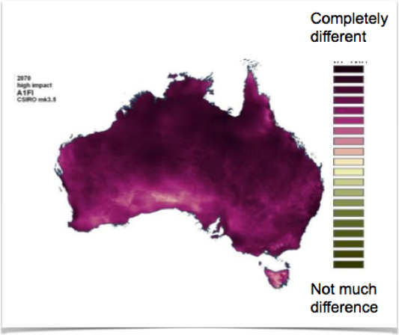
Climate &
ecological change
Ferrier et al.

Slide 4
Communication
Every second there are…..
2.5 million emails sent
10,000 tweets
40,000 google searches

Slide 5
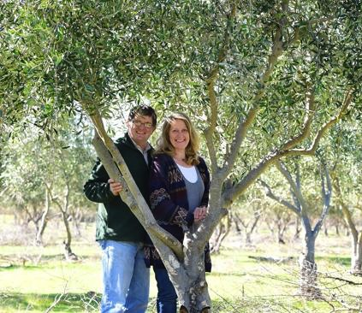
Picture: Zoe Phillips Source: News Limited
Race et al.2011
Demographic
& social change

Slide 6
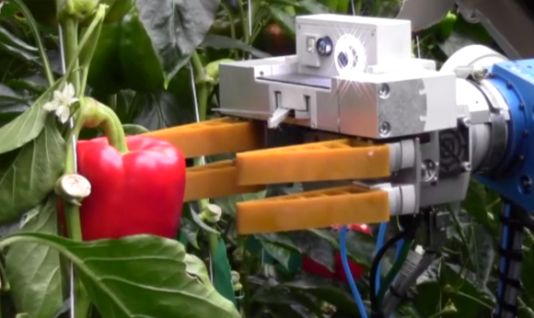
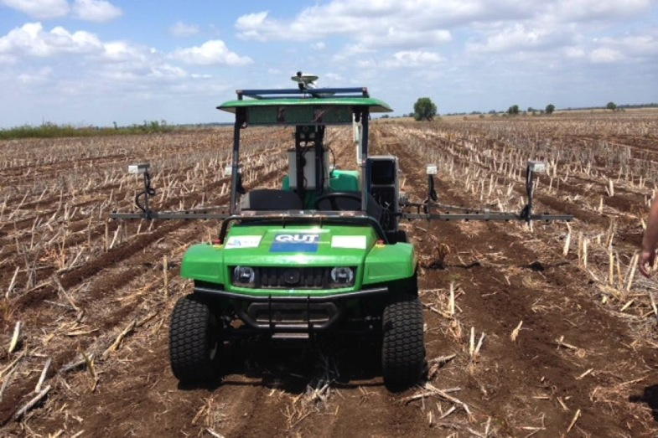
“… five million Australian jobs around 40% of the workforce…replaced by computers in the next 10 to 15 years”
CEDA 2015
Technology

Slide 7
Climate &
ecological change
Communication
?
Demographic
& social change
Technology

Slide 8
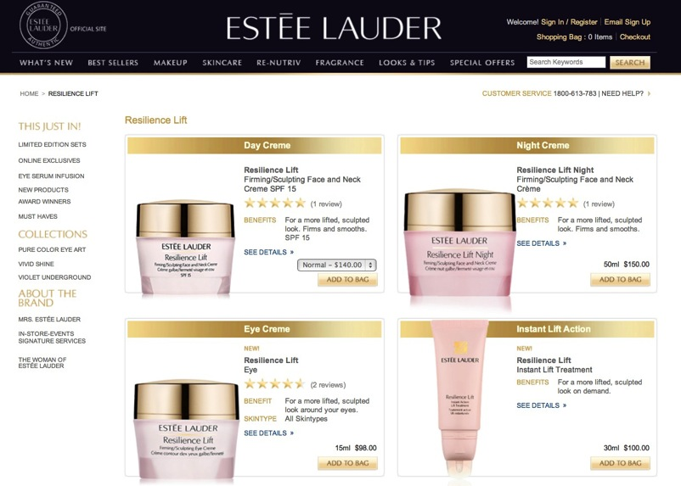
Resilience

Slide 9
Resilience?
The capacity of a system (eg farm, ecosystem, social system, industry) to self organise and cope with major change while retaining a desired identity or creating a new identity when needed.
Two key concepts for thinking about complex problems:
1. Adaptive cycle
2. Networks

Slide 10
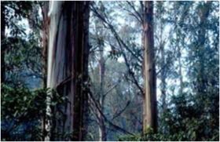
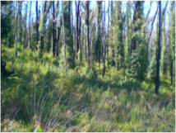
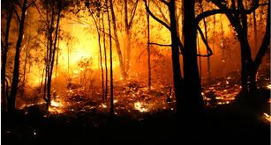
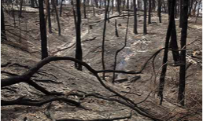
1. Adaptive cycle (or cycles of change)
conservative
growth
collapse
reorganise

Slide 11
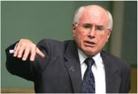
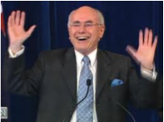
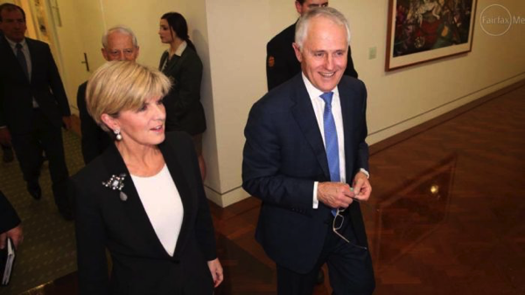
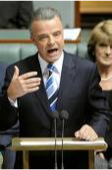
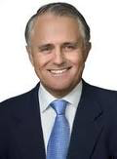
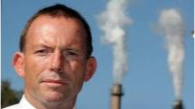
1. Adaptive cycle

Slide 12
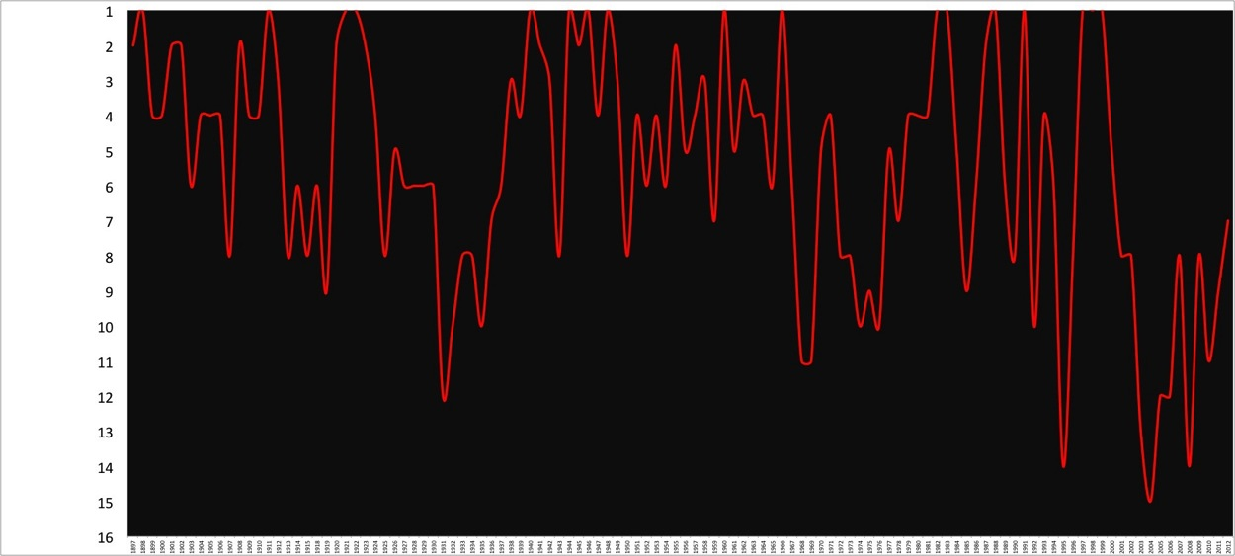
See the Bombers fly up……and down!
Ladder position
Year

Slide 13
Regional
collective
Landcare network
Landcare group

Slide 15
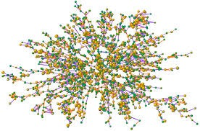
2. Networks
networks - the connections between people
powerful motivating force motivating change, changing norms and behaviours……but
 | Contacts | Contacts contacts | Contacts contacts contacts
Happiness | 15% | 10% | 6%
Obesity | 45% | 20% | 10%
Smoking | 61% | 29% | 11%

Slide 16
Survey data from 88% of peanut farmers in
Queensland shows a strong negative correlation
between transformational capacity and both place and occupational attachment Marshall et al. 2012
Social network
Information network
Dowd et al. 2014

Slide 17
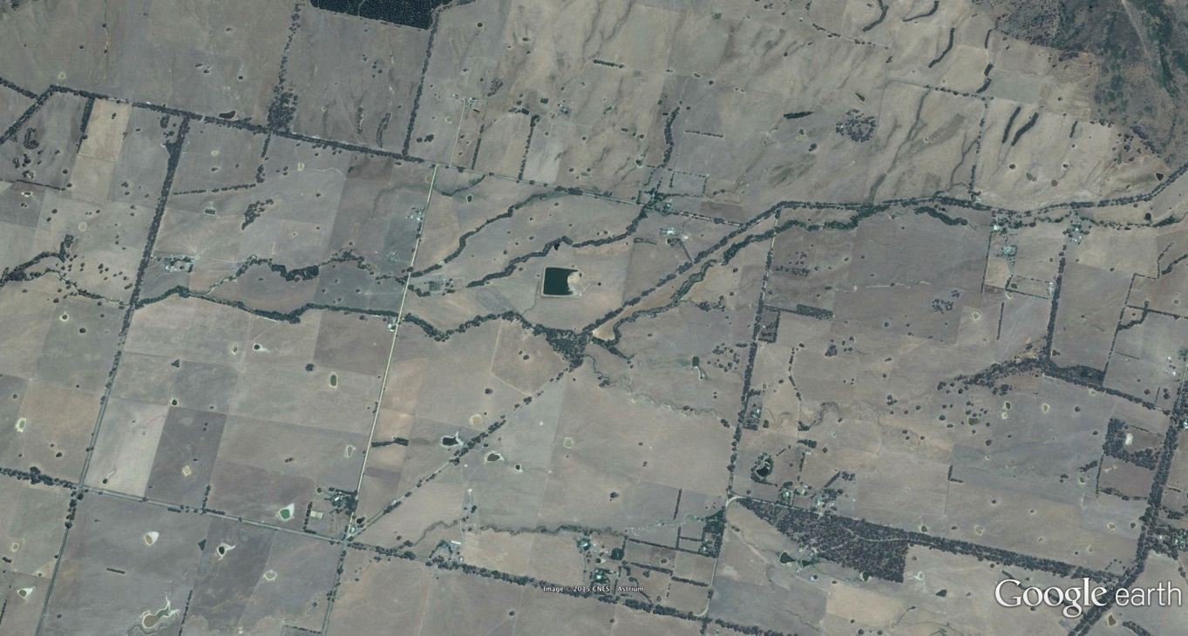

Slide 18
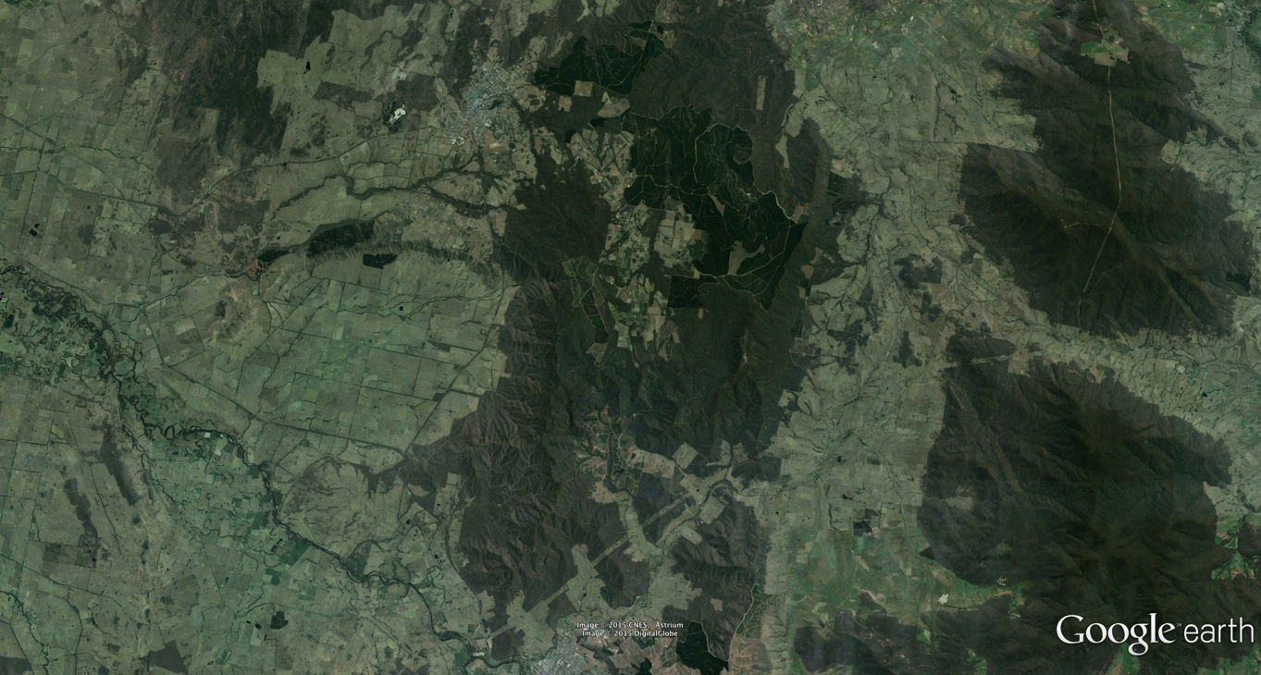

Slide 20
What is the future of Landcare in a changing context?
what is the role of Landcare in the transition of the Australian continent? leader? inspirer? innovator? supporter of others to change? a connector? a bridge?
where is Landcare on the adaptive cycle? Growth? Conservation? Collapse? Reorganisation? Is it building or shedding connections and capital?
‘neighbours’ versus ‘knowledge’ networks - is a place based model the best approach in a transitioning world? What model will best help people adapt or transform?
is Landcare about incremental or transformational change?

Slide 21
Thank you!
Paul Ryan
0488 636 802
paul.ryan@ausresilience.com.au
@ausresilience

